Slide 1
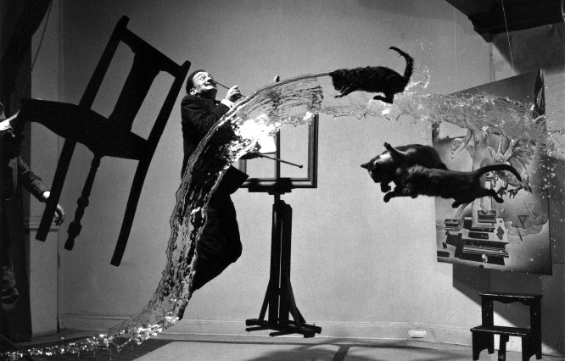
SCAMPER
Images of Imagination and Innovation

Slide 2
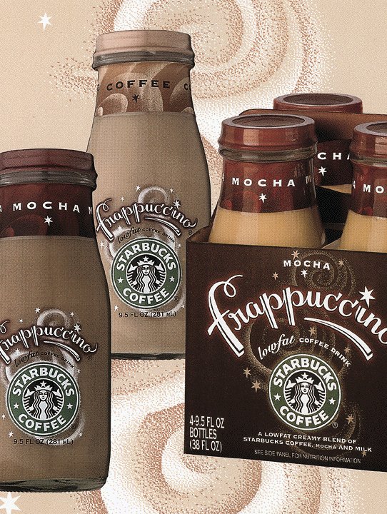
SUBSTITUTE
One thing replaces another thing.
A Starbucks manager experimented by substituting flavours.
The result was a $500 million business.

Slide 3
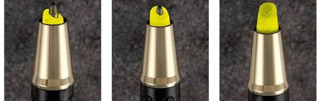
combine
Two or more things joined to make a new thing.
Schaffer Company combined a ball point pen with a highlighter, called the Prelude MPI.

Slide 4
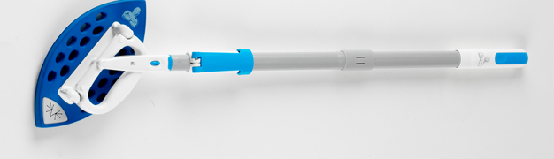
adapt
A hotel guest in Puerto Rico watched a maid clean a bathroom ceiling with a rag tied to a broom handle. The guest went home and designed telescopic handle and cleaning head. Sales are $150 million per year.
Make one thing suitable for another use.

Slide 5
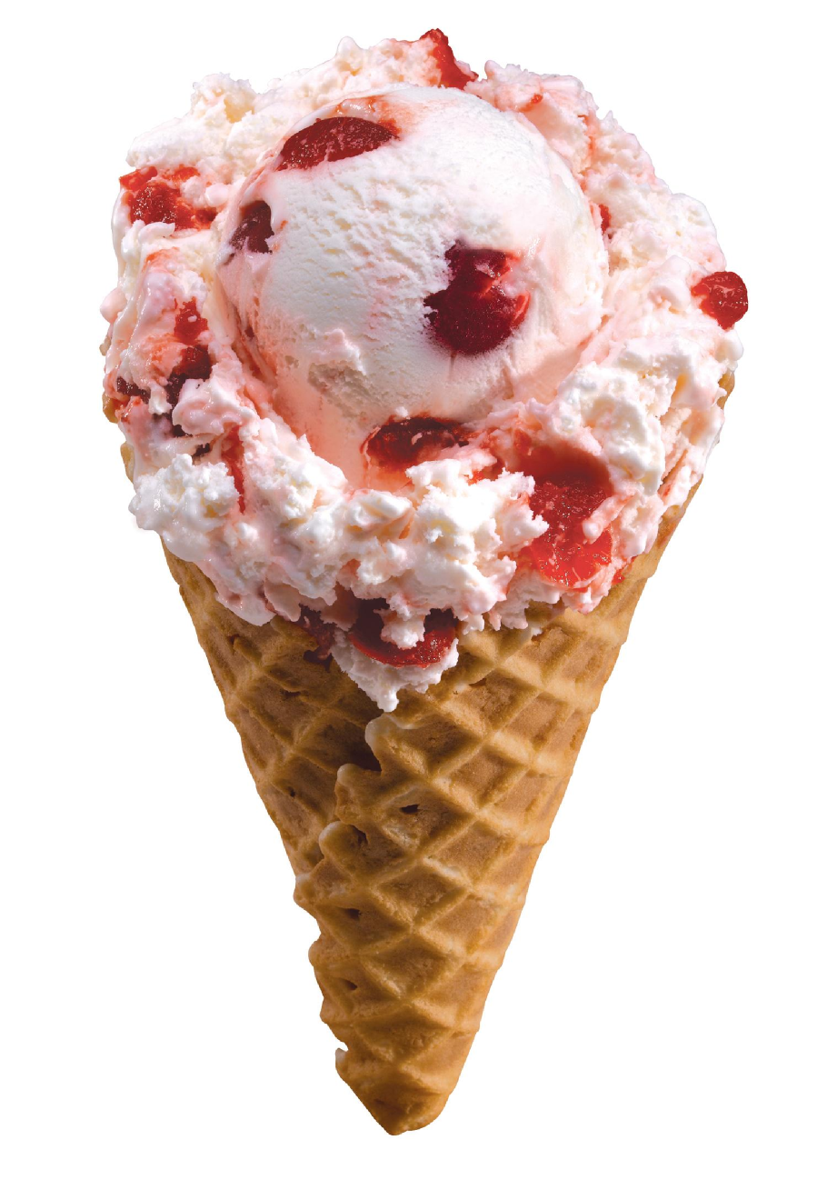
MODIFY
Change the form or character
A hot day at the 1905 World Fair. People bought ice cream. Not hot waffles.
When the ice cream seller ran out of dishes, waffle seller Ernest Hamwi had an idea.
Changed the shape of the flat waffle into a cone. Used it as an ice cream holder. Birth of the ice cream cone.

Slide 6
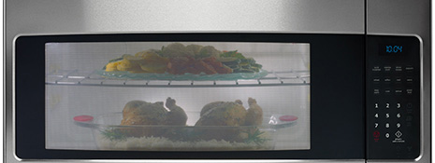
PuT TO OTHER USES
Find another benefit.
Microwaves were invented during WW2 by the British. In the 1950s, an accident in a lab showed scientists that microwaves could cook food.

Slide 7
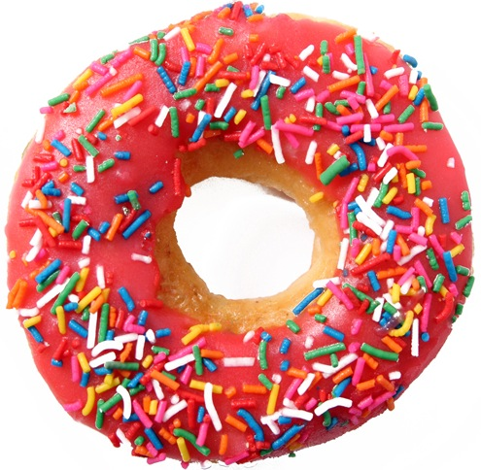
ELIMINATE
Get rid of, remove.
Originally, donuts did not have holes.
According to legend, a boy watched his mother cook donuts. He saw the center did not cook well.
So he cut out the center. Birth of the modern donut.

Slide 8
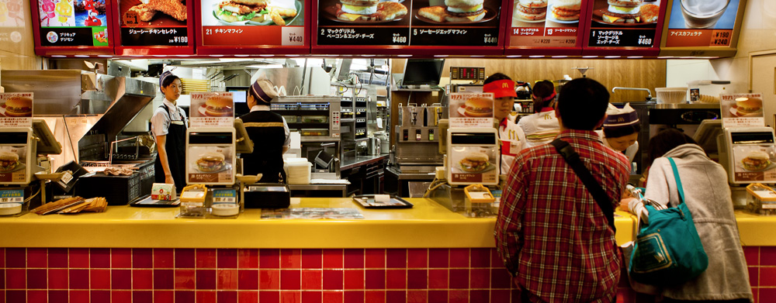
rearrange
Put in new order.
McDonald’s rearranged the inside of restaurants. Customers pay first and then eat. Birth of fast food.

Slide 9
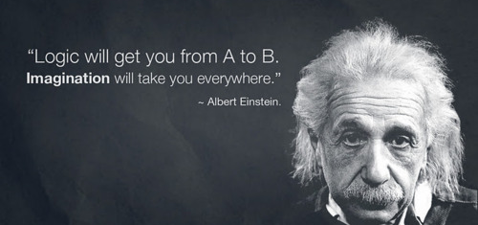
SCAMPER
substitute - combine – adapt – modify -
put to other uses - eliminate - rearrange

